Slide 1
Sage CRM Bootcamp 2015
Sage CRM 7.3
  Eoin Shanley
    17 February 2015

Slide 2
 | Agenda
1.0 | Sage CRM 7.3
1.2 | Business Accelerators
1.3 | Mobile Web
1.4 | Sage CRM for iPhone & Android
1.5 | New UI Theme
1.6 | MailChimp Integration
1.7 | Enhancements
2.0 | New UI Theme
2.1 | What’s new
2.2 | Differences between Cloud & On-Premise
2.3 | Upgrade tips
3.0 | MailChimp
3.1 | Why MailChimp?
3.2 | Using the integration
4.0 | Enhancements
4.1 | Product enhancements
5.0 | Other release notes
6.0 | Summary

Slide 3

Sage CRM 7.3
Insightful CRM for small and medium sized companies looking to accelerate sales performance and drive sales productivity.
Sales alerts

Slide 4
Sage CRM 7.3
Feature Overview
Business Accelerators for Sales
Sage CRM Mobile Web
Sage CRM for iPhone & Android
MailChimp Integration
Enhancements
Updated User Interface

Slide 5
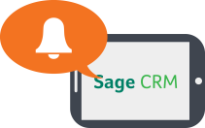
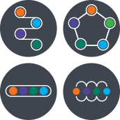
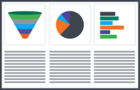


Sage CRM 7.3
Business Accelerators for Sales
The Business Accelerator suite includes:
A range of preconfigured alerts and notifications
New out-of-the-box workflows for sales to suit more complex or simpler sales processes
New sales dashboards that display a range of new KPIs, charts, reports and leaderboards for better insight and trend analysis
The ability to email PDF Quotes & Orders with just one click for rapid sales follow up

Slide 6
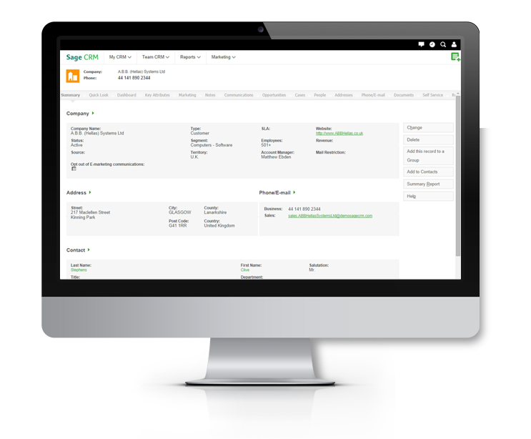
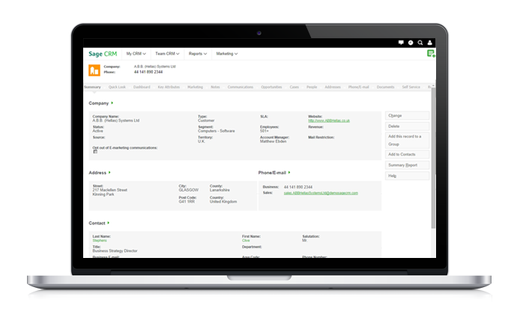
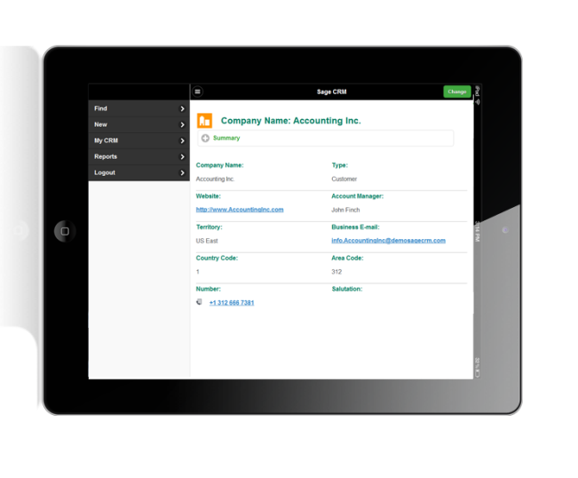
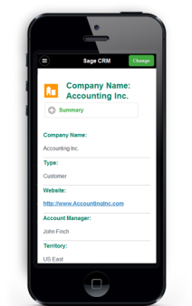
Sage CRM 7.3
Sage CRM for Mobile
Contemporary theme for mobile web users
Unified customer experience across all smartphones and tablets
Single theme for all devices so you can customise and deploy once, regardless of what devices your company use
Uses latest mobile web development framework
Support for Android, iPhone, iPad, Windows 8, etc.

Slide 7
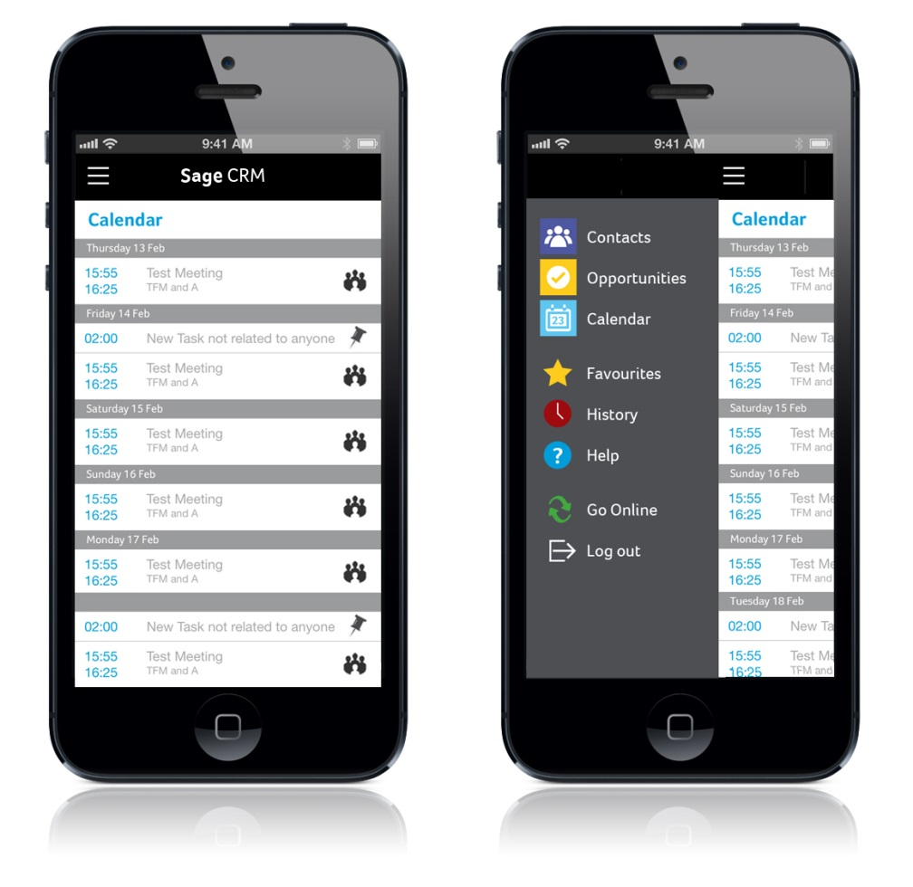
Sage CRM 7.3
Sage CRM for iPhone
Updated Sage CRM iPhone app for Sales users with a range of new enhancements
Contemporary look and feel with updated menu
Ability to display custom fields for people and opportunities
Add phone contact as Person or Lead in Sage CRM
Improved calendar layout
Add appointments & tasks

Slide 8
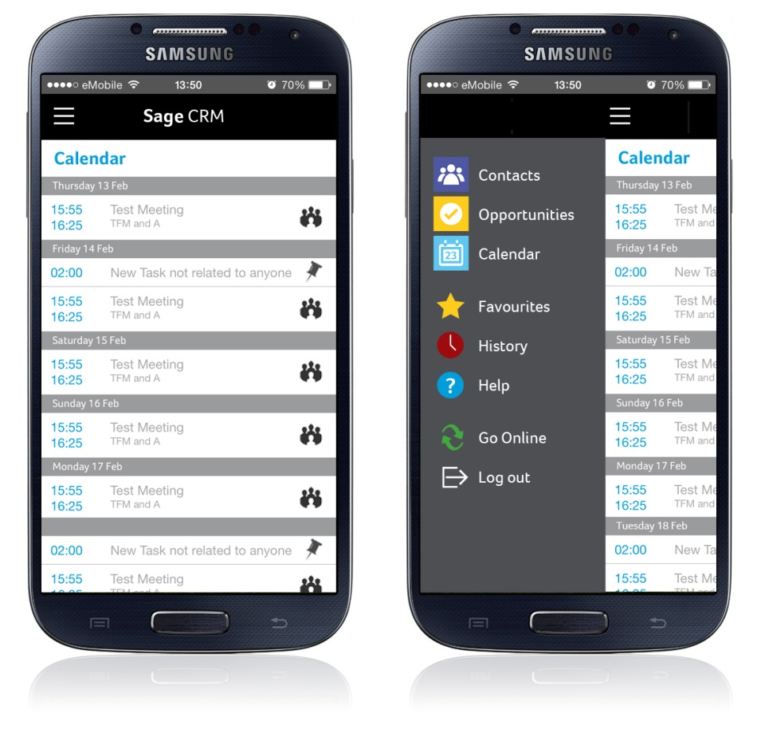
Sage CRM 7.3
Sage CRM for Android
New Sage CRM Android app so Sales users can access Sage CRM data regardless of location or network access
Access to People and Opportunities records, including their recent Communications and Cases
Easily navigate to recently viewed People and Opportunities
Mark records as Favourites
Record SMS, Emails and Calls as Communications in Sage CRM
Add appointments & tasks
Add phone contact as Company & Person or Lead in Sage CRM
Ability to display custom fields for people and opportunities
Contemporary look and feel with intuitive calendar layout

Slide 9
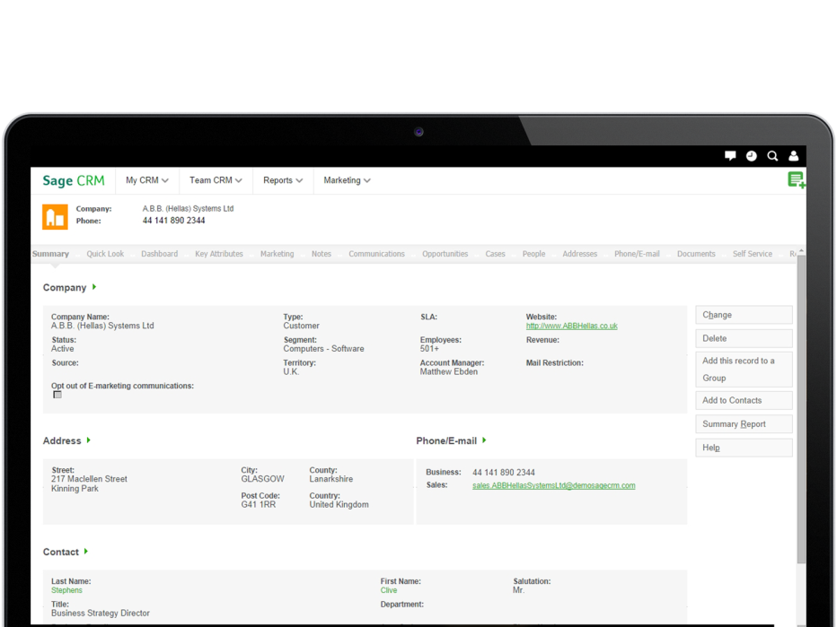
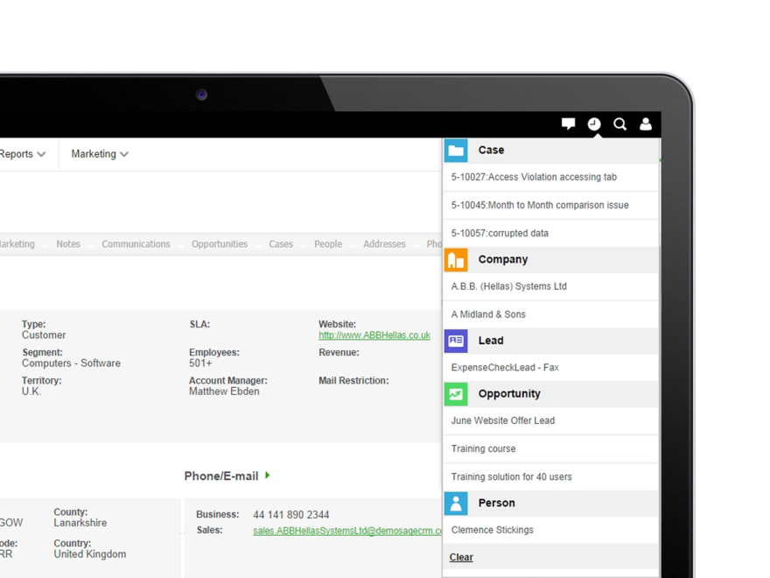
Sage CRM 7.3
New contemporary look and feel
Contemporary look and feel for Sage CRM 7.3
New layout and icons
Available as an optional theme, set as default for new users

Slide 10


Sage CRM 7.3
MailChimp Integration
Sage CRM
Push Sage CRM contacts into MailChimp
Quickly and easily create new targeted email marketing campaigns in Sage CRM
Send the campaign and automatically add a communication record to the relevant records in Sage CRM
View a list of sent MailChimp campaigns in Sage CRM and gain valuable insight into the results - opens, clicks, bounces and more
Segment lists and create groups based on responses for future campaigns

Slide 11

The new look for Sage CRM 7.3
sagecrm.com

Slide 12
Sage CRM 7.3
Contemporary Theme & Branding updates
Installer & login screen updated
New desktop shortcut icon
Left hand navigation moved to top of the screen & split into 2 sections
Workflow and action buttons re-styled
Admin area icons updated

Slide 13
Sage CRM 7.3
Differences between Cloud & On-Premise
Functional changes: search, favourite records & integrated with notifications
Only theme available
New admin navigation
Look & feel only
Choice of 2 themes for new installs, 4 for upgrades
New admin icons

Slide 14
New Theme
Contemporary Theme
Optional User Interface theme for existing Sage CRM customers (Upgrades)
Default theme for new Sage CRM customers
New css file: WWWRoot\Themes\ergonomic.css
Some client side customisations may need to be tweaked by BPs to work with new theme.
Make sure you are using a supported browser (e.g. IE11 with compatibility mode turned off)

Slide 15
Sage CRM 7.3
Contemporary UI Theme - Demo

Slide 16
Sage CRM 7.3
Upgrade tips
Customisations that use client side scripting to directly manipulate the HTML DOM (document object model) are most likely to be affected
In particular:
        Buttons & workflow actions (icons removed)
        Left menu (removed)
        Page structure (logo area etc)
Use the Client side API whenever there is a method that meets your requirements – ask us if there isn’t one!

Slide 17

A new choice for your email marketing
sagecrm.com

Slide 18

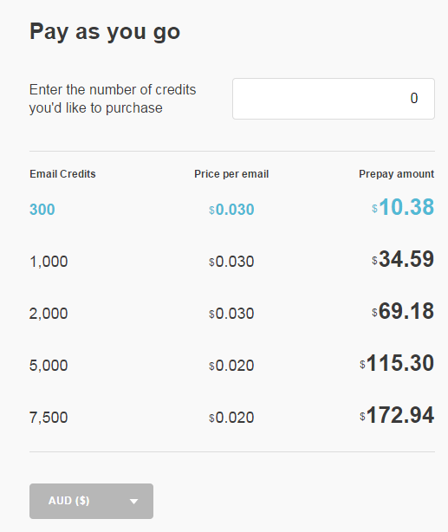
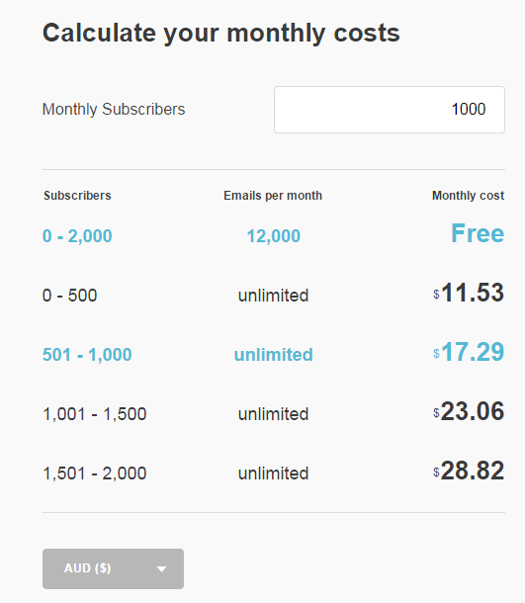
Sage CRM 7.3
MailChimp
Why MailChimp?
        MailChimp is specifically requested more than any other provider
        Their pricing is competitive & transparent
        They provide a free subscription: up to 12,000 emails to 2,000 subscribers per month
        No expiring trial or credit card required for free subscription
        They have a robust, well documented and rich API
The MailChimp integration is a offered as an alternative choice – SwiftPage is still an option for customers with more advanced requirements

Slide 19
Sage CRM 7.3
MailChimp
Overview:
Configuration requires only 2 fields to be populated in the administration area
Sync Company, Lead & Person records to a MailChimp “master list”
Create segments of this list based on Sage CRM Search results
Create campaigns in Sage CRM and select a segment
        Campaigns are stored as a communication in Sage CRM
View the campaign statistics in Sage CRM – results updated automatically, or can be refreshed manually
        Create groups based on the results
        Opt-outs have mail preferences updated automatically
Notes:
Template editing is all done in MC
Groups from results can then be created as new segments

Slide 20
Sage CRM 7.3
MailChimp
Step by step instructions available in the “What’s New” guide & help files.
Every hour, data from all campaigns is synchronized from MailChimp to Sage CRM so you can see updated statistics about recipient interaction with your campaign emails.
My CRM | MailChimp Campaigns.
MailChimp Terms:
API Key: Key for setting up an integration with MailChimp http://kb.mailchimp.com/accounts/management/about-api-keys
Global List: This is the master list of Contacts in MailChimp that emails can be sent to
Segment: This corresponds to a group in CRM and is a subset of the Global List in MailChimp

Slide 21
Sage CRM 7.3
MailChimp Configuration
Set up MailChimp Integration in CRM in
Administration | Email and Documents | MailChimp Integration.
Follow the on screen instructions to create an account and generate:
          MailChimp API Key
          MailChimp List ID
Configuration settings available in Custom_SysParams:
select * from Custom_SysParams where Parm_Name like '%MailChimp%'

Slide 22
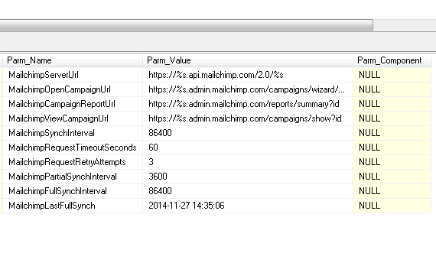
Sage CRM 7.3
MailChimp – Custom SysParams

Slide 23
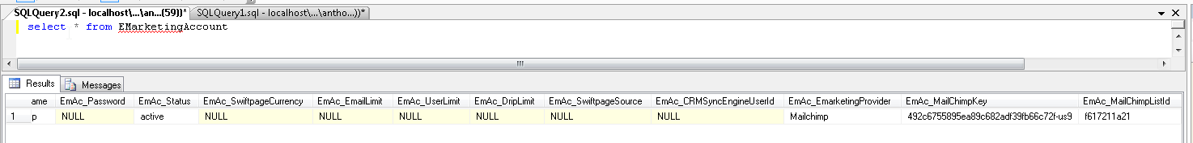
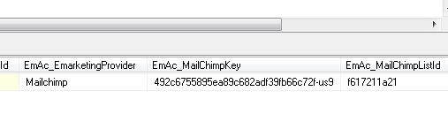
Sage CRM 7.3
MailChimp – changes to DB tables
New columns added to : EmarketingAccount
EmAc_EmarketingProvider
EmAc_MailchimpKey

Slide 24
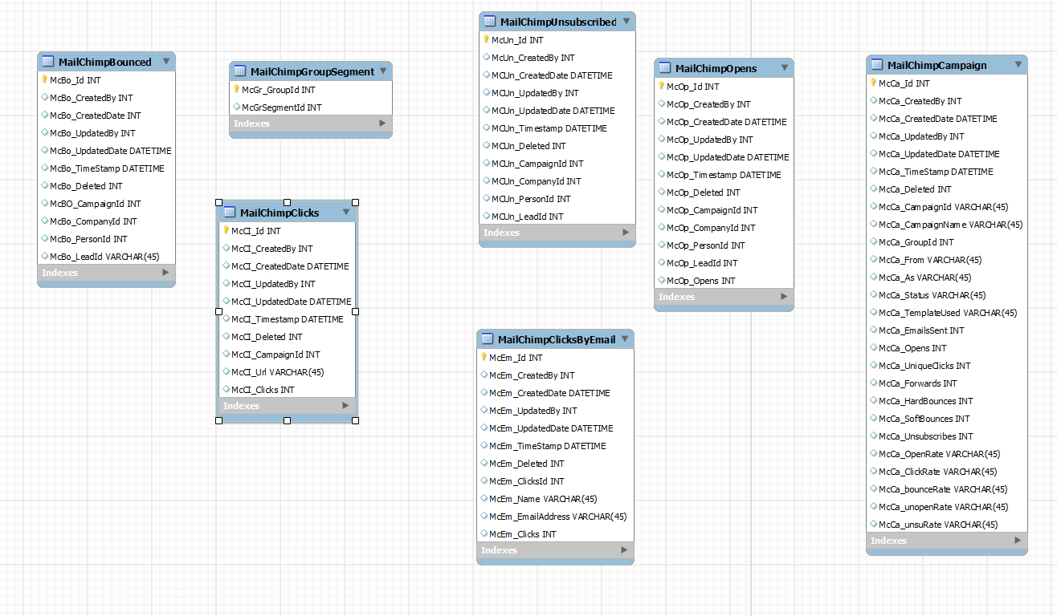
Sage CRM 7.3
MailChimp – new DB tables

Slide 25
Sage CRM 7.3
MailChimp – new tables
Results
Group ->
Segment
Map
Campaign Details

Slide 26
Sage CRM 7.3
MailChimp - Logs
Logging levels for MailChimp Integration set in the file: "tomcat\webapps\crm73j\WEB-INF\log4j.xml
    <logger name="com.sage.crm.mailchimp" additivity="false">
    <level value="ERROR"/>
    <appender-ref ref="mailchimp"/>
    </logger>
Logs output to the Logs\<date>mailchimp.log file
JSON used instead of XML to pass information between CRM & mailchimp:
Request body: {"apikey":"73e0a89dc288f402dd06c253ad547915-us9"}
Response body: {"msg":"Everything's Chimpy!"}

Slide 27
Sage CRM 7.3
MailChimp operational notes
All API operations run through Java
      Mailchimp API: https://apidocs.mailchimp.com/api/2.0/
Errors will be logged in Mailchimp.log (new log file)
Scheduled job runs every hour by default (Can be forced by clicking refresh button in MailChimp campaign in CRM)
Full sync job runs every 24 hours
    - Including opt outs
Scheduled job runs on primary server in multi-server environment
Notes:
Partial Sync -> Every hour data from all campaigns is synchronized from MailChimp to Sage CRM so you can see updated statistics about recipient interaction with your campaign emails
Full Sync -> opt outs Synced. Every night, a communication record is created for each email recipient.

Slide 28
Sage CRM 7.3
MailChimp - Demo

Slide 29

Enhancements
sagecrm.com

Slide 30
Sage CRM 7.3
Enhancements
Lead deduplication - entering leads manually and lead data uploads
Match rules dedupe on an OR/AND basis
Currency symbol & decimal places on chart gadgets
CK Editor updated to latest version – full screen edit box

Slide 31
Sage CRM 7.3
Lead deduplication
When deduplication is enabled, Sage CRM now searches for duplicate records on Lead entities using match rules of type "contains" on Lead Company Name and Lead Person Last Name.
As a System Administrator, you can specify that the lead dedupe rules look for matches on either or both Lead Company Name and Lead Person Last Name fields. Click Administration | System | System Behavior and choose And or Or from Deduplication Rule.
To add fields to the Lead deduplication screen go to Administration | Data Management | Match Rules
When deduplication is enabled, you must set a deduplication rule for the Lead Company Name and Lead Person Last Name fields when you're uploading Lead data.

Slide 32
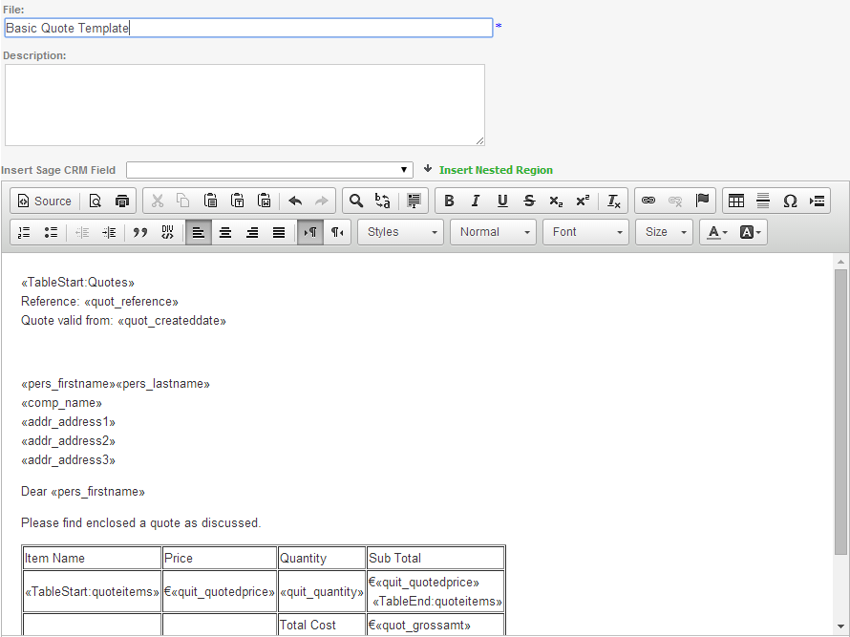
Sage CRM 7.3
CK Text Editor
The Sage CRM text editor has been enhanced so it’s easier for you to create the body of a mail merge or email template.
You can maximize the editor to help you see your work more clearly, and your spelling is automatically checked as you type.

Slide 33
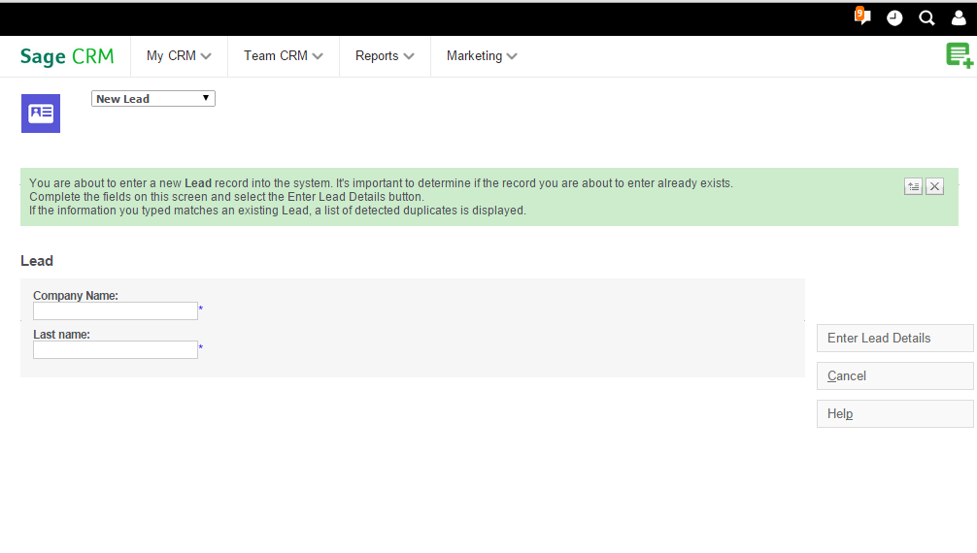
Sage CRM 7.3
Enhancements - Demo

Slide 34

Other notes
sagecrm.com

Slide 35
Sage CRM 7.3
Add-ons updated
Updated components/installers available in 7.3 for:
      Facebook Integration
      Yammer Integration
      Advanced Customisation Wizard
      Sage CRM SDK
http://community.sagecrm.com

Slide 36
Sage CRM 7.3
Support matrix – notable changes
Latest Software Support Matrix file available on the community site
Internet Explorer 11 only; compatibility mode no longer supported
Sage CRM 7.0: no longer supported
Sage CRM 7.1: hotfixes only
Sage CRM 7.2: fully supported through quarterly patches
Microsoft SQL 2014 (Enterprise and Standard Editions) supported on 7.3
Oracle no longer supported in 7.3 for new installs or upgrades

Slide 37
Summary
sagecrm.com

Slide 38
Sage CRM 7.3
Summary
Business Accelerators for Sales
Sage CRM Mobile Web
Sage CRM for iPhone & Android
MailChimp Integration
Enhancements
Updated User Interface

Slide 39








Accelerate your business success with Sage CRM
sagecrm.com

